Slide 1

Mini project 2.
LIBRARY MANAGEMENT SYSTEM
-Saili Randive

Slide 2
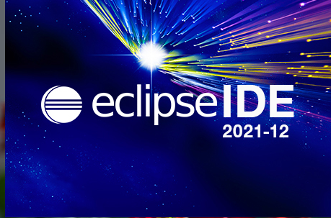

INTRODUCTION
DEVELOPMENT TOOLS
JDK ECLIPSE 15.0.2
MYSQL

Slide 3
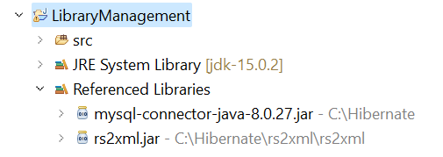
External jar files
mysql-connector-java-8.0.27 to connect database to the project
rs2xml.jar is used to implement Jtable properly.

Slide 4
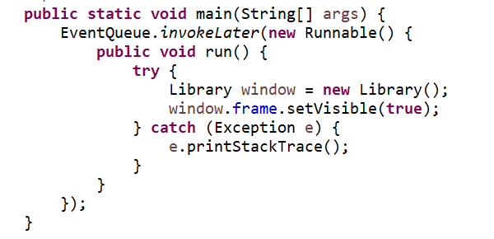
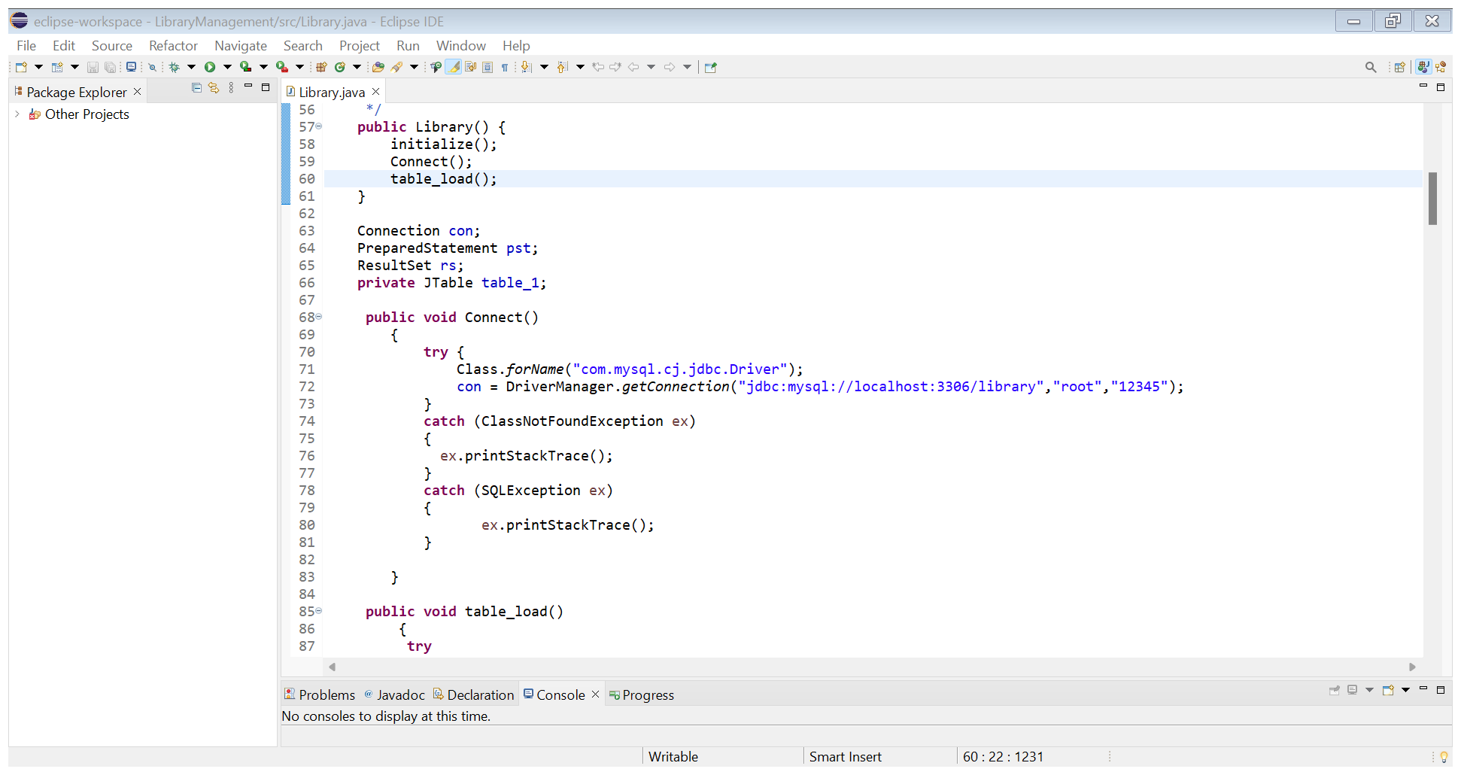
…
In Main Method, I have created a whole Swing Frame.
Then I created a connection object to connect the Database.
I have created a connect method, which connects the Database to the project.

Slide 5
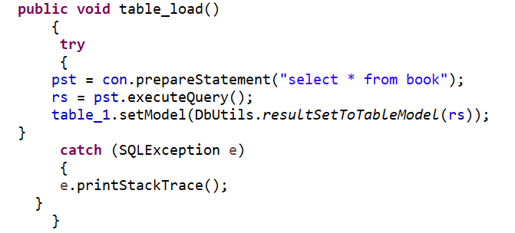
….
Created a Prepared statement object to execute queries that defined the Jtable object.
Table_load → table_load method that loads the database table into java application.

Slide 6
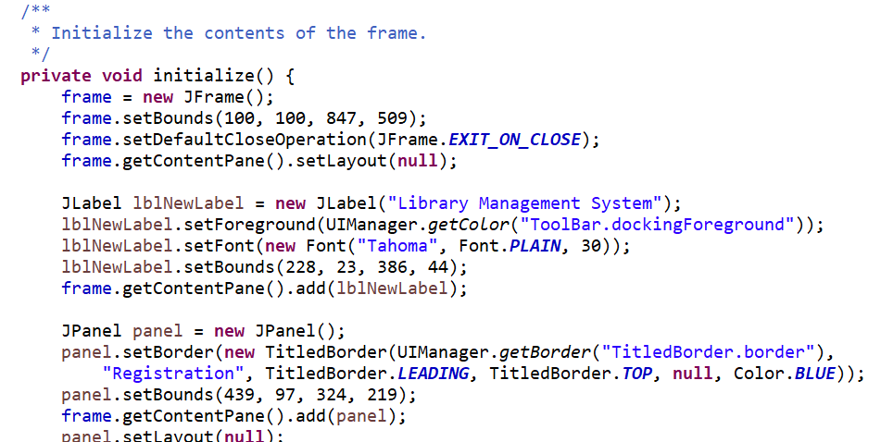
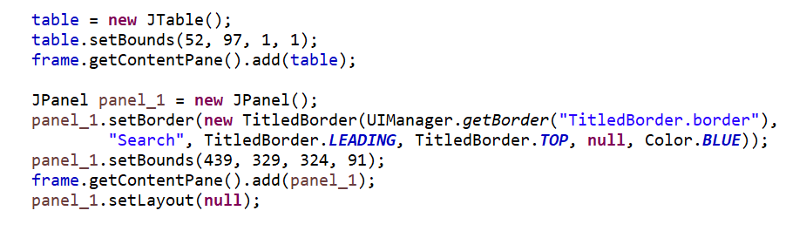
Initializing the contents of the frame.
Initializing the contents of the frame through initialize method.
Inside this method, we have created a new JFrame setting its bound.
Created a label “Library Management System”
The remaining part of the frame is divided into three parts i.e
Jtable
Registration panel
Search panel

Slide 7
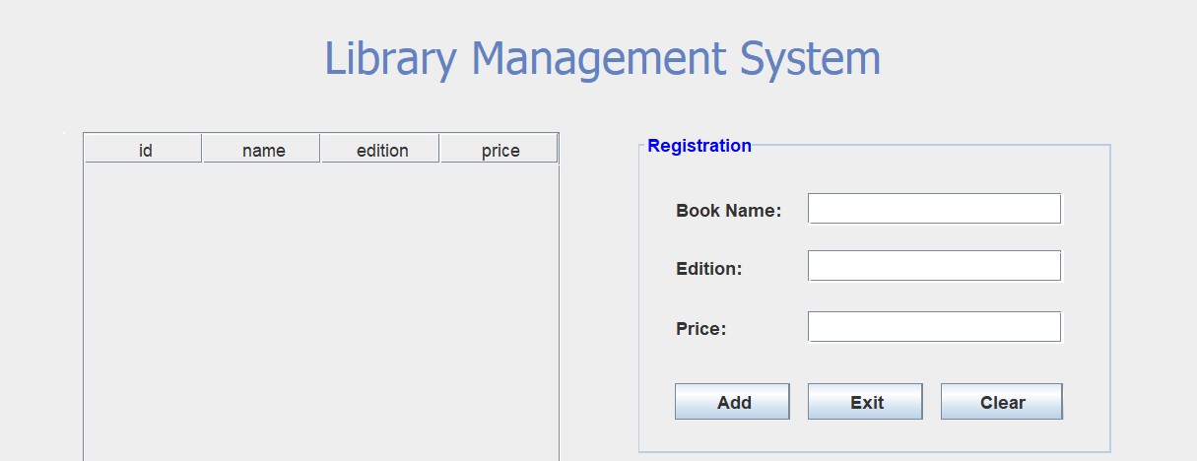
J table displays database table.
Registration panel contains text-field for book name, book edition, book price along with this there are three buttons namely - Share, Exit, Clear.
Add button executes insert query to insert name addition and price into the database.

Slide 8
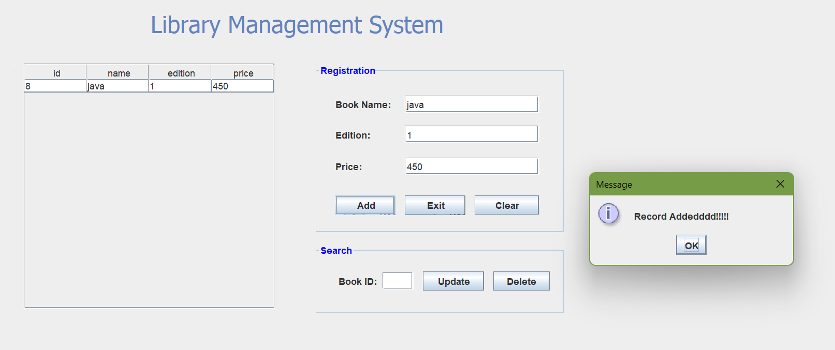
It shows the message “Record added”

Slide 9
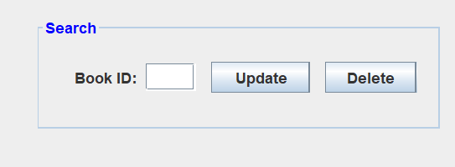
The search panel contains a text field to search for book Id and an update and delete button.

Slide 10
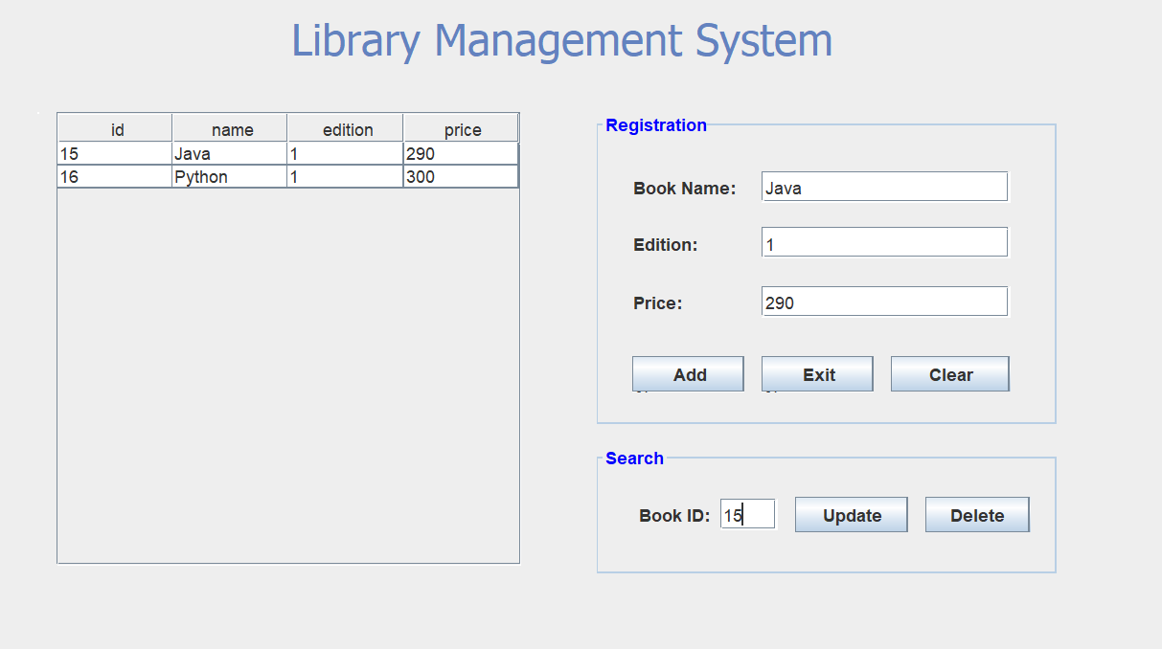
Key released is the method that helps us to display book details of the respective Id entered into the book id text field.

Slide 11
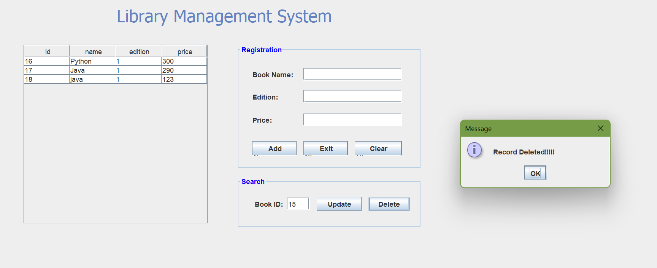
Update executes update query which alters name, edition, and price of the book that we have searched and then shows a message “record updated”.
Delete button executes delete query that deletes the record matched with the Id entered in the book Id text field and then it shows a message “Record deleted”

Slide 12



THANK YOU
SAILI RANDIVE
7888011718
sailirandive1953@gmail.com
.....

